Slide 1
Keras
UIUC ECON 490: Applied Machine Learning in Economics

Slide 2
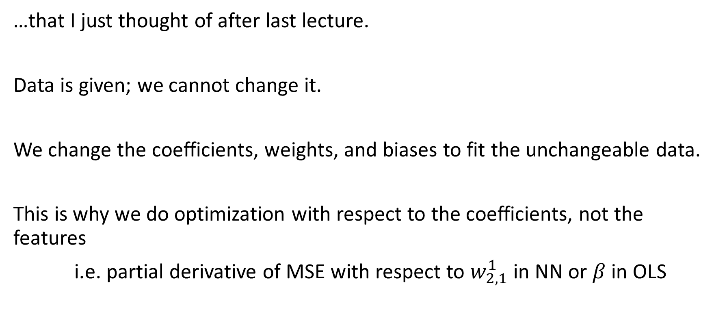
A clarifying note on fitting algorithms…
…that I just thought of after last lecture.
Data is given; we cannot change it.
We change the coefficients, weights, and biases to fit the unchangeable data.
This is why we do optimization with respect to the coefficients, not the features
i.e. partial derivative of MSE with respect to $w_{2,1}^{1}$ in NN or $β$ in OLS

Slide 3
Neural Networks – I have tons of complex data
Neural networks excel with…
Complex patterns
A large amount of data
Google – TensorFlow & Keras
Keras – Extremely versatile, user friendly API (what we will use)
TensorFlow – Extreme customization
HoML Ch10 and Ch11 in one day! Woo!

Slide 4
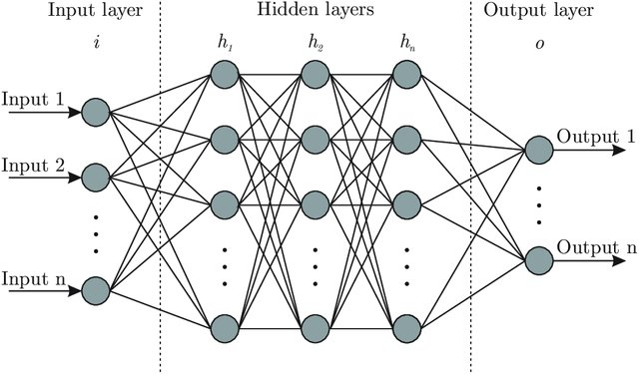
Feed-forward NN

Slide 5
The Keras Neural Network Process
Initialize
What kind of layers – “architecture”
Which hidden activation functions
Which output activation functions
Compile
Which loss and metric
Which optimizer
Regularization
Fit
Learning rate schedule
Batch size
Early stopping
Validation split
Epoch
Evaluate
Predict

Slide 6
Initialization
The neural network skeleton

Slide 7
Architecture - Sequential NN/ANN/MLP

Slide 8
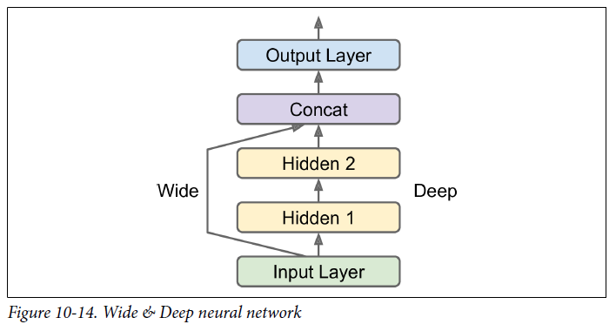
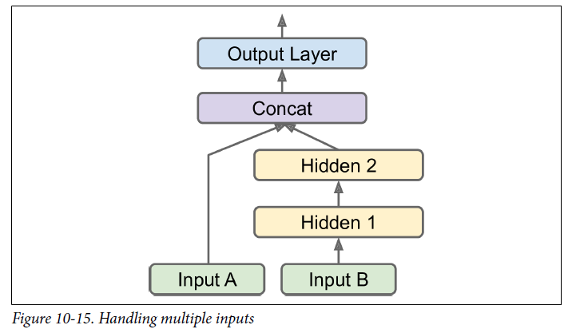
Examples of other architectures
Long-short term memory (LSTM) – signals (next lecture)
Convolution neural networks (CNN) – image (2 lectures away)

Slide 9
Rules of thumb for determining “deepness” of NN
Keras layers link
A neural network is “deep” if it has more than 1 hidden layer
“Advanced” can be 100s of layers deep
For us, 1-5 should be sufficient
How to decide depth:
Shallow – Data has very few patterns
Deep – Data has very specific (complex) patterns
i.e. Predicting wages vs. classifying words from sound waves

Slide 10
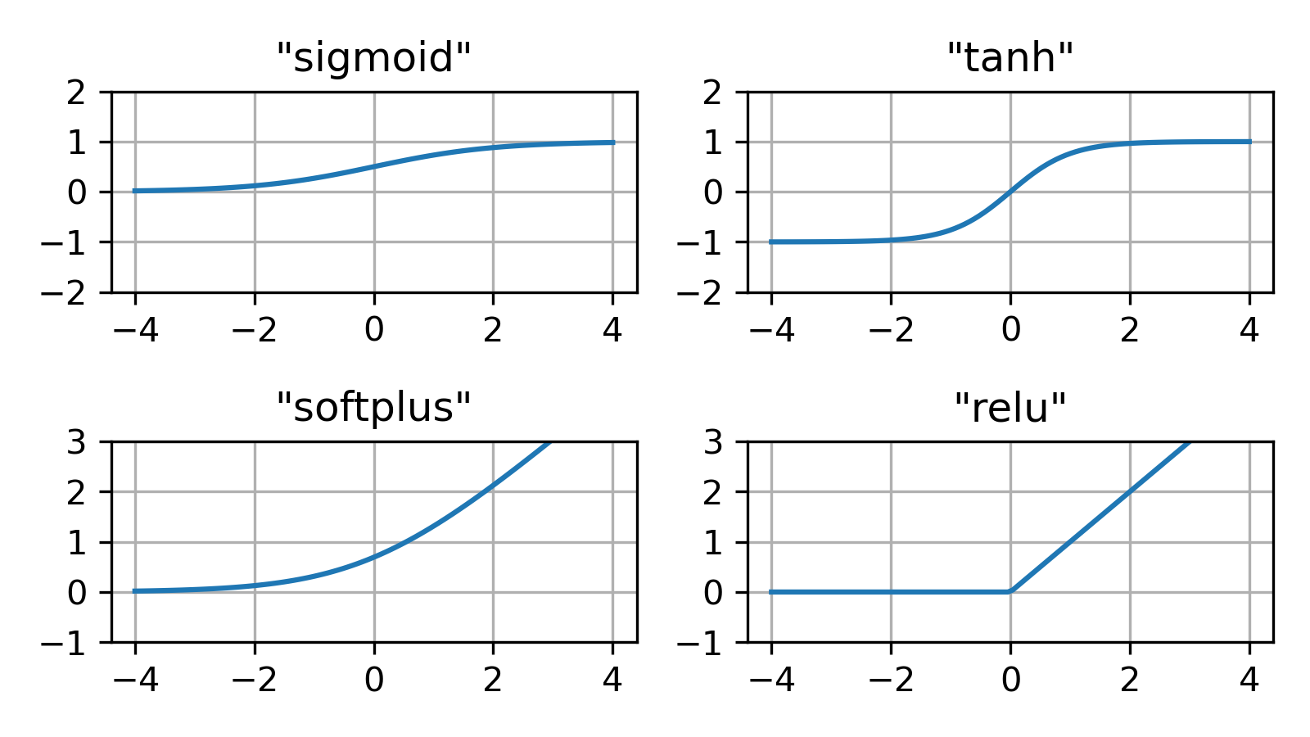
Hidden Layer Activation Functions

Slide 11
Vanishing/exploding gradient problem
Input layer – top layer output layer – bottom layer
Vanishing gradient problem – As algorithm converges to a minima, lower layer gradients become smaller
Exploding gradient problem – the opposite (an issue with RNN, next lecture)
Activation functions could be the culprit!
Sigmoid – derivative nearly zero almost everywhere
ReLU – derivative zero for all negative values (neurons can die)

Slide 12
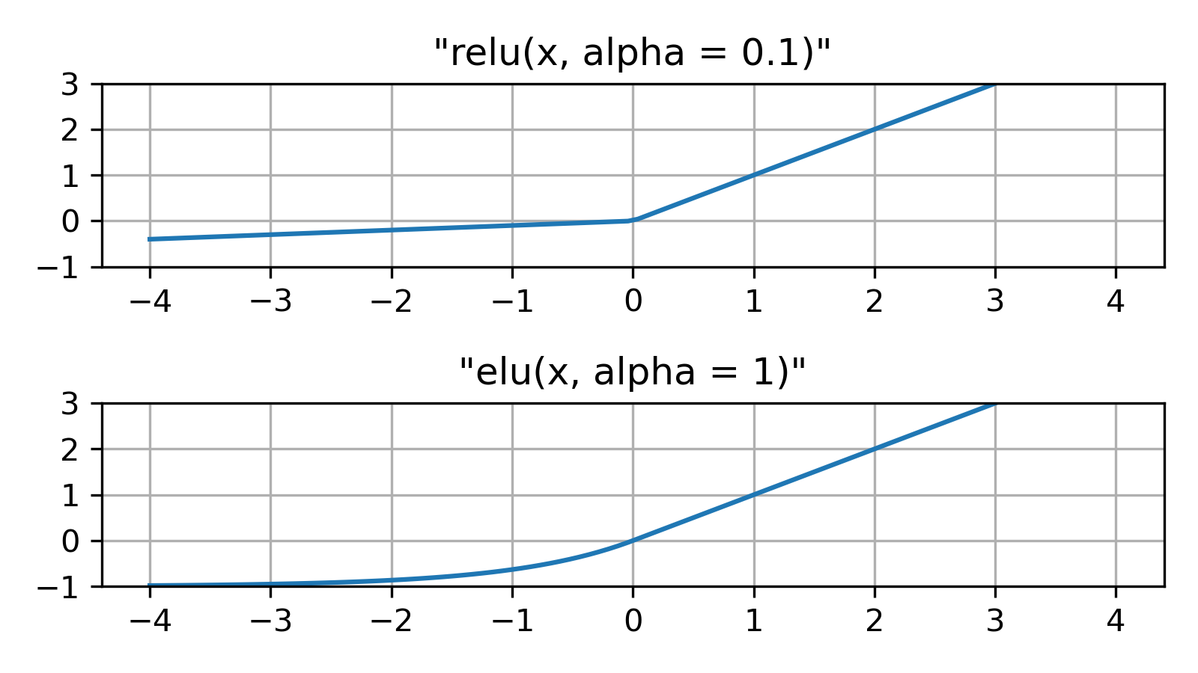
Leaky ReLU & Exponential Linear Unit

Slide 13
Output Layer Activation Fns Determine Predictions
Regression
Positive
ReLU
Softplus
Positive or Negative
None (linear)
Bounded
Sigmoid [0, 1]
Tanh [-1, 1]
Classification
Binary
Sigmoid
Multiclass
Softmax
Multiple Binary Labels
Sigmoid
Keras activation functions link

Slide 14
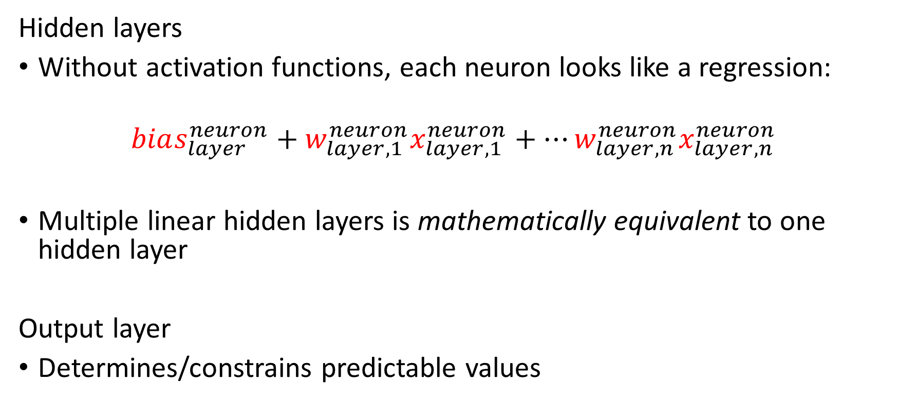
Why do we need activation functions?
Hidden layers
Without activation functions, each neuron looks like a regression:
$$bias_{layer}^{neuron}+w_{layer, 1}^{neuron}x_{layer,1}^{neuron}+…w_{layer, n}^{neuron}x_{layer,n}^{neuron}$$
Multiple linear hidden layers is mathematically equivalent to one hidden layer
Output layer
Determines/constrains predictable values

Slide 15
The Many Hyperparameters
Initialization
Which features to use
Number of hidden layers/architecture
Which activation functions
Activation functions’ hyperparameters

Slide 16
Compilation
Fleshing out the neural network skeleton

Slide 17
Losses and metrics
Losses – objective function
Regression
MSE, MAE
Classification
Categorical cross-entropy
Metrics – reported performance
Regression
RMSE, MSE, MAE
Classification
Accuracy, entropy, true positives, etc.

Slide 18
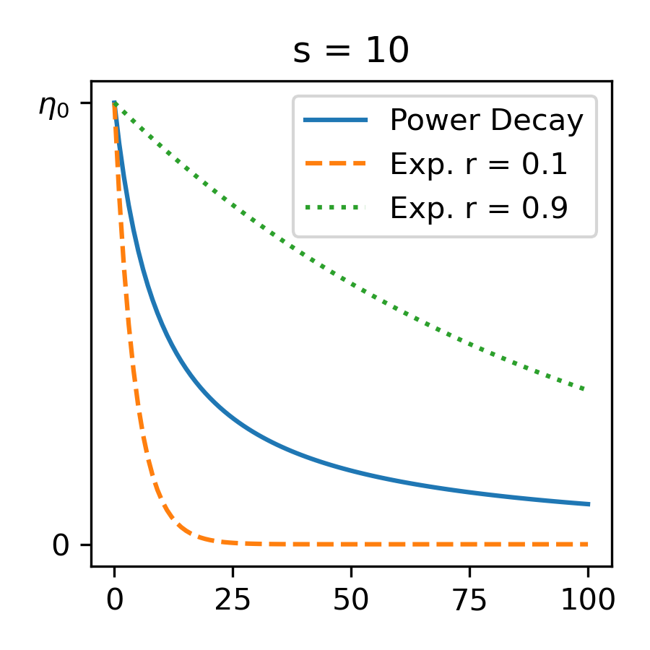
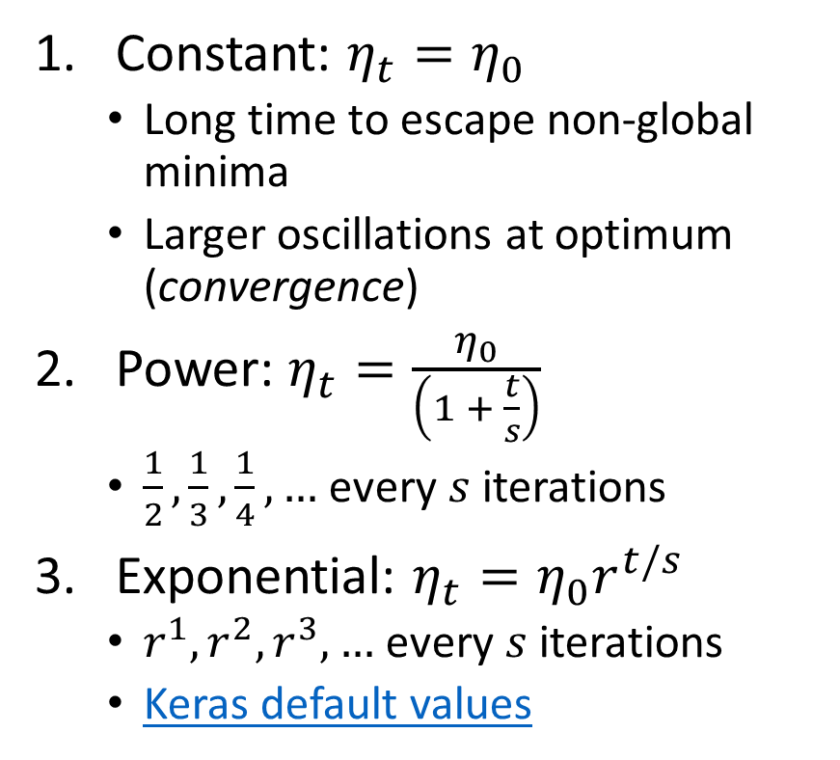
Learning Rate ($η$) Schedules
Constant: $η_{t}=η_{0}$
Long time to escape non-global minima
Larger oscillations at optimum (convergence)
Power: $η_{t}=\frac{η_{0}}{\left(1 + \frac{t}{s}\right)}$
$\frac{1}{2},\frac{1}{3},\frac{1}{4},…$ every $s$ iterations
Exponential: $η_{t}=η_{0}r^{t/s}$
$r^{1}, r^{2},r^{3},…$ every $s$ iterations
Keras default values

Slide 19
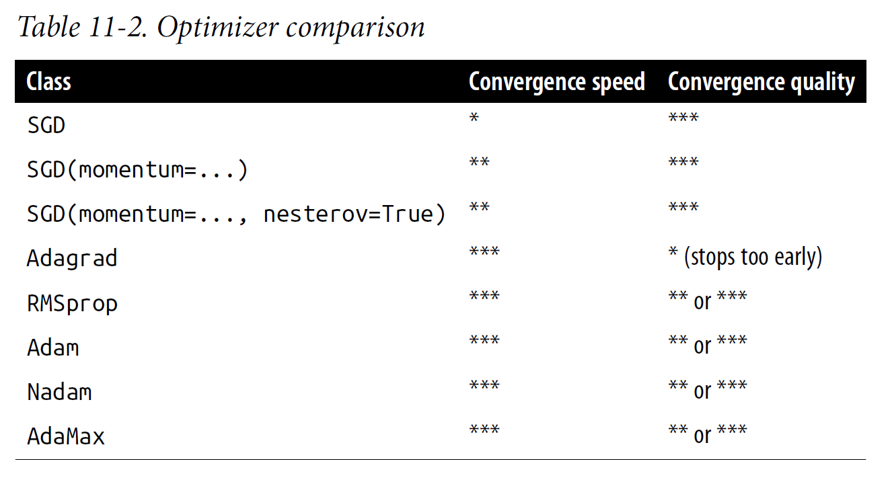
Two mb-SGD Optimizers (others for context)

Slide 20
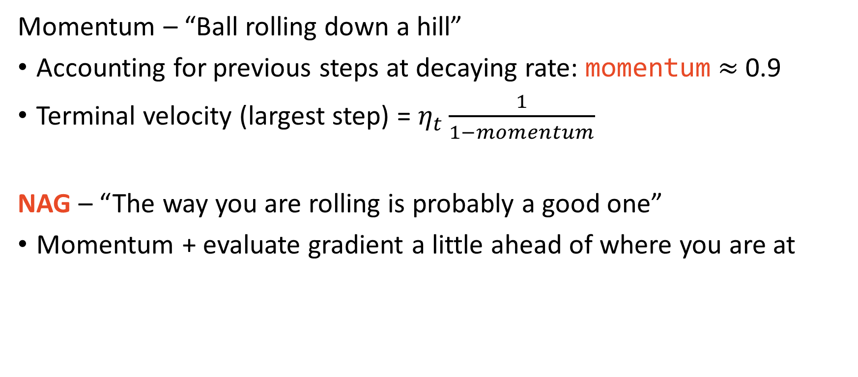
Momentum & Nesterov Accelerated Gradient
Momentum – “Ball rolling down a hill”
Accounting for previous steps at decaying rate: momentum $≈$ 0.9
Terminal velocity (largest step) = $η_{t}\frac{1}{1−momentum}$
NAG – “The way you are rolling is probably a good one”
Momentum + evaluate gradient a little ahead of where you are at

Slide 21
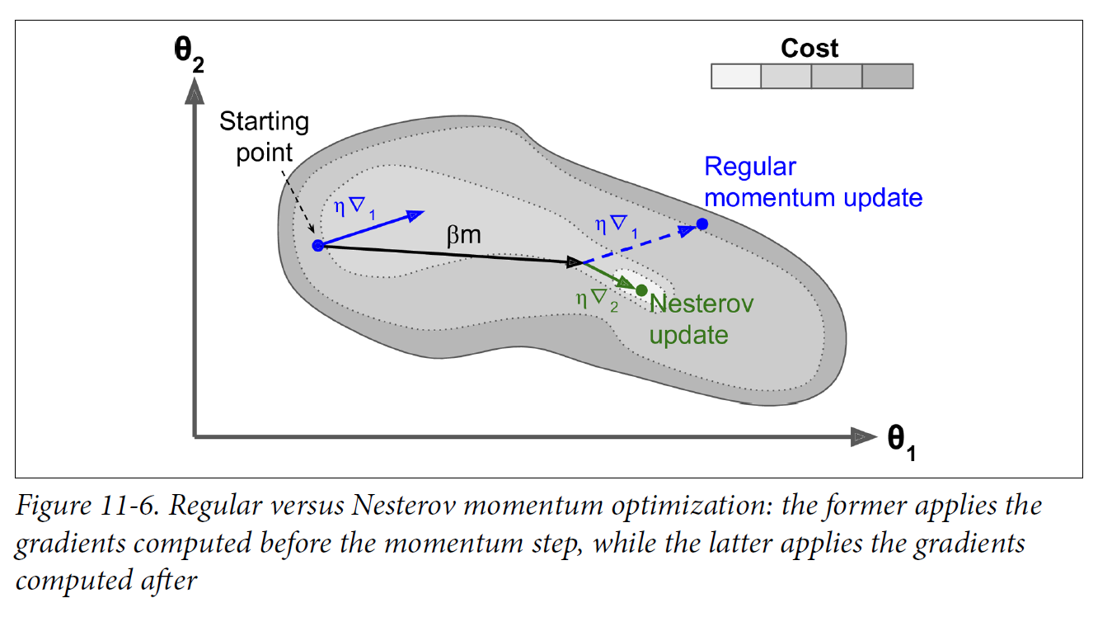
Momentum & NAG visually

Slide 22
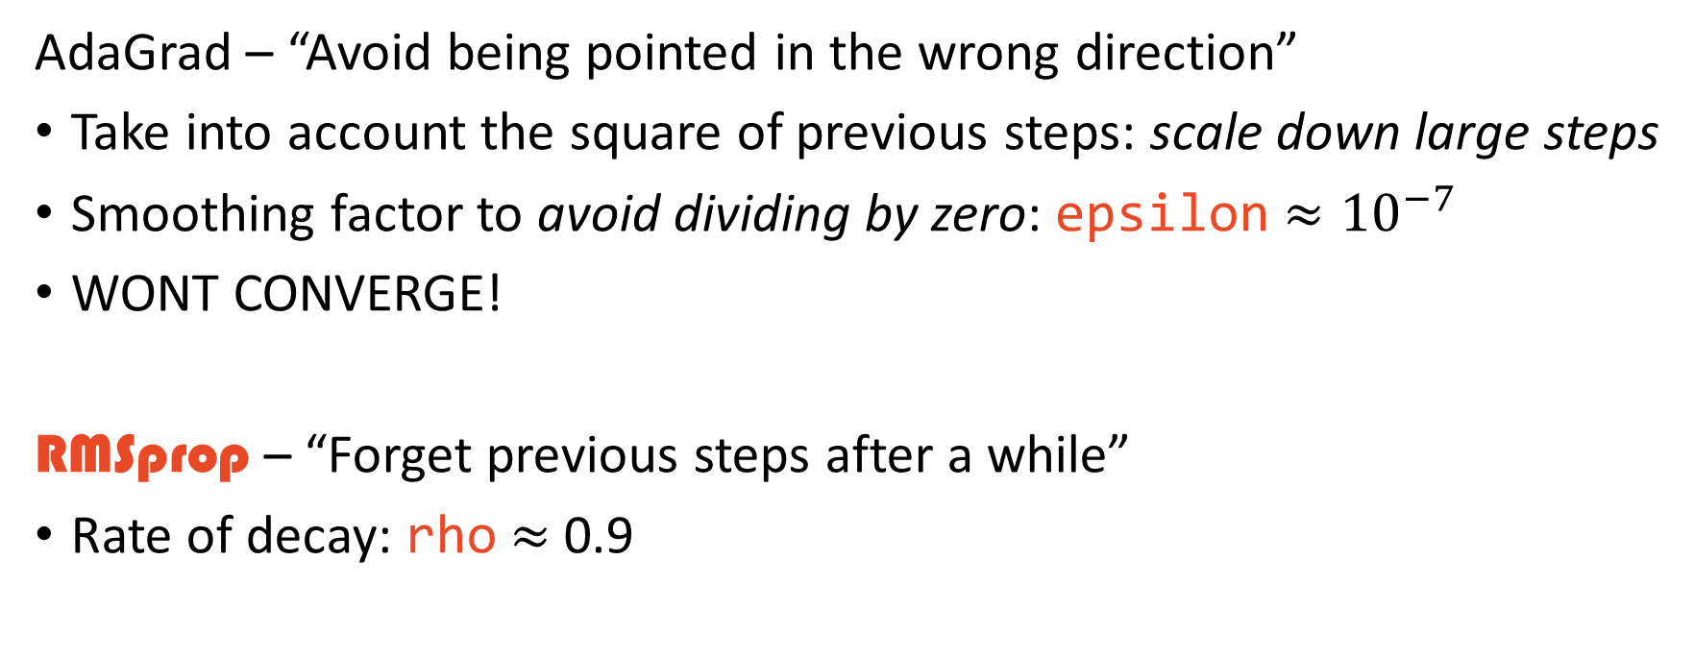
Adaptive Subgradient (AdaGrad) & Root Mean Square Propagation (RMSprop)
AdaGrad – “Avoid being pointed in the wrong direction”
Take into account the square of previous steps: scale down large steps
Smoothing factor to avoid dividing by zero: epsilon $≈{10}^{−7}$
WONT CONVERGE!
RMSprop – “Forget previous steps after a while”
Rate of decay: rho $≈$ 0.9

Slide 23
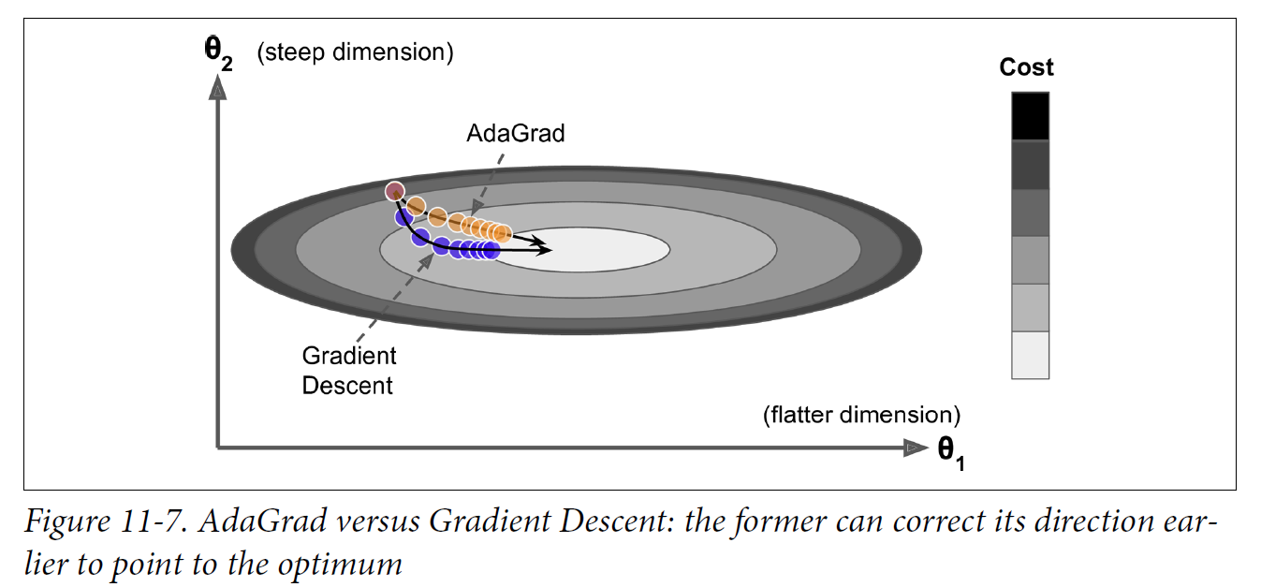
AdaGrad Visually

Slide 24
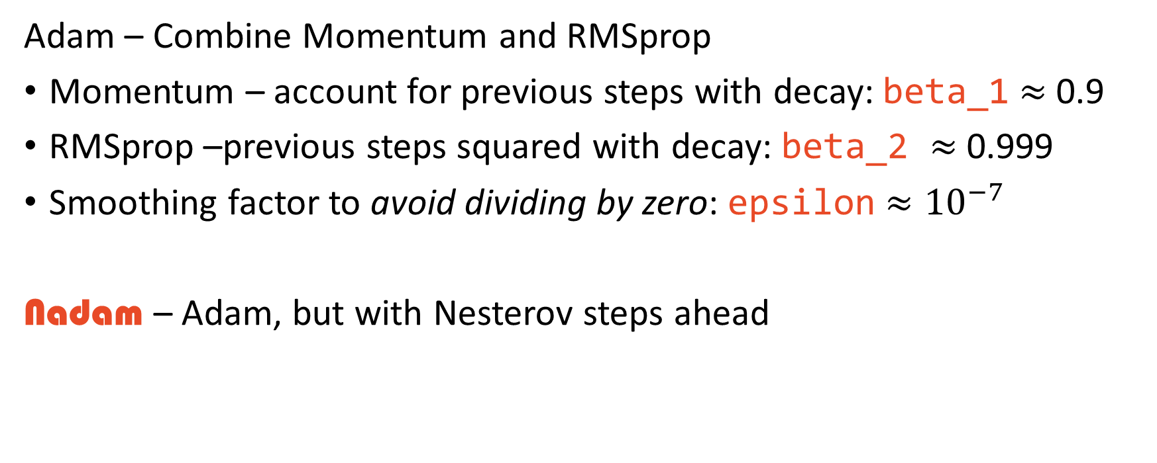
Adapative Moment Estimation (Adam) & Nesterov Adam (Nadam)
Adam – Combine Momentum and RMSprop
Momentum – account for previous steps with decay: beta_1 $≈$ 0.9
RMSprop –previous steps squared with decay: beta_2 $≈$ 0.999
Smoothing factor to avoid dividing by zero: epsilon $≈{10}^{−7}$
Nadam – Adam, but with Nesterov steps ahead

Slide 25
How to decide optimizer
Order:
RMSprop
Simpler momentum optimizer
Nadam
A bigger canon
May take slightly longer
Nesterov Momentum
As the textbook says, “your dataset may just be allergic to adaptive gradients”
That is, corrections to the steps taken

Slide 26
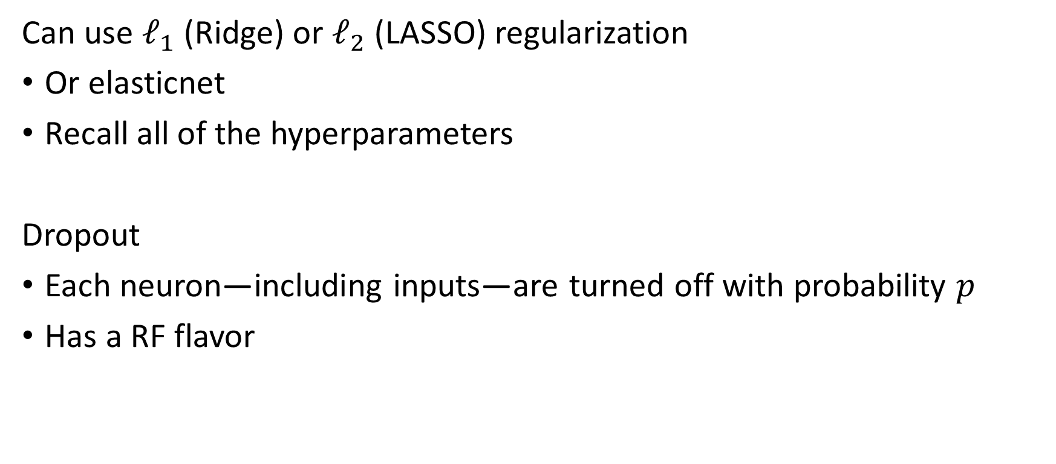
Regularization (not covered: HoML Ch11)
Can use $ℓ_{1}$ (Ridge) or $ℓ_{2}$ (LASSO) regularization
Or elasticnet
Recall all of the hyperparameters
Dropout
Each neuron—including inputs—are turned off with probability $p$
Has a RF flavor

Slide 27
The Many Hyperparameters
Initialization
Which features to use
Number of hidden layers/architecture
Which activation functions
Activation functions’ hyperparameters
Compilation
Which learning schedule
Learning schedule hyperparameters (if applicable)
Which optimizer
Optimizer hyperparameters
Regularization
More omitted techniques from HoML Ch11

Slide 28
Fitting
Some continuation of the “fleshing out the skeleton” analogy, like dressing the neural network or figuring out its personality or something like that. Man, PowerPoint gives you a lot of space for the subtext on these section slides… There is still a whole other line I could be using! Got it!

Slide 29
But wait! There’s more!
Keras model training link
batch_size: 32
Any number between 16-96
validation_split: 0.0
callbacks
Early stopping (no improvement): patience = None

Slide 30
The Many Hyperparameters
Initialization
Which features to use
Number of hidden layers/architecture
Which activation functions
Activation functions’ hyperparameters
Compilation
Which learning schedule
Learning schedule hyperparameters (if applicable)
Which optimizer
Optimizer hyperparameters
Regularization
More omitted techniques from HoML Ch11
Fitting
Batch size
Validation split
Early stopping rounds
All before touching the data!

Slide 31
Evaluation and Prediction
The easy part

Slide 32
Evaluation and prediction are super straight forward
model.evaluate(x_test, y_test)
model.predict(x_test)

Slide 33
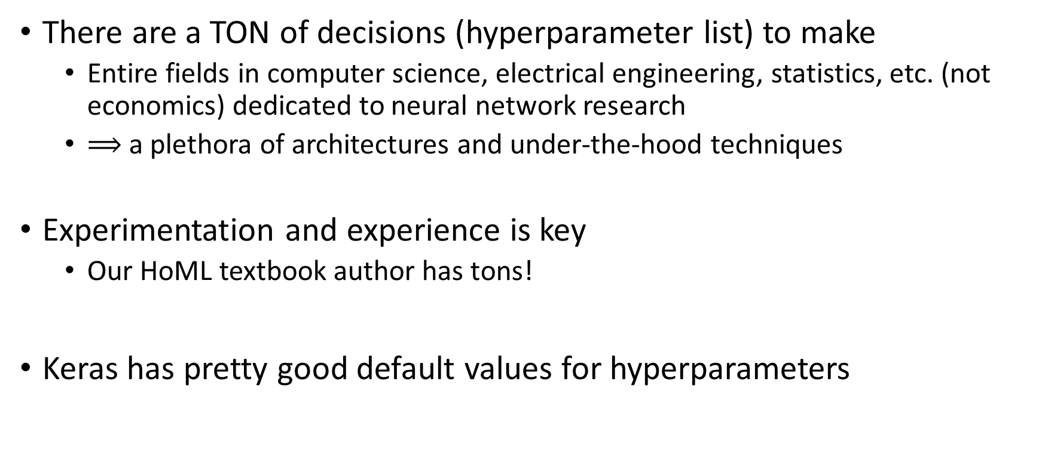
Main Takeaways
There are a TON of decisions (hyperparameter list) to make
Entire fields in computer science, electrical engineering, statistics, etc. (not economics) dedicated to neural network research
$⟹$ a plethora of architectures and under-the-hood techniques
Experimentation and experience is key
Our HoML textbook author has tons!
Keras has pretty good default values for hyperparameters

